Slide 1

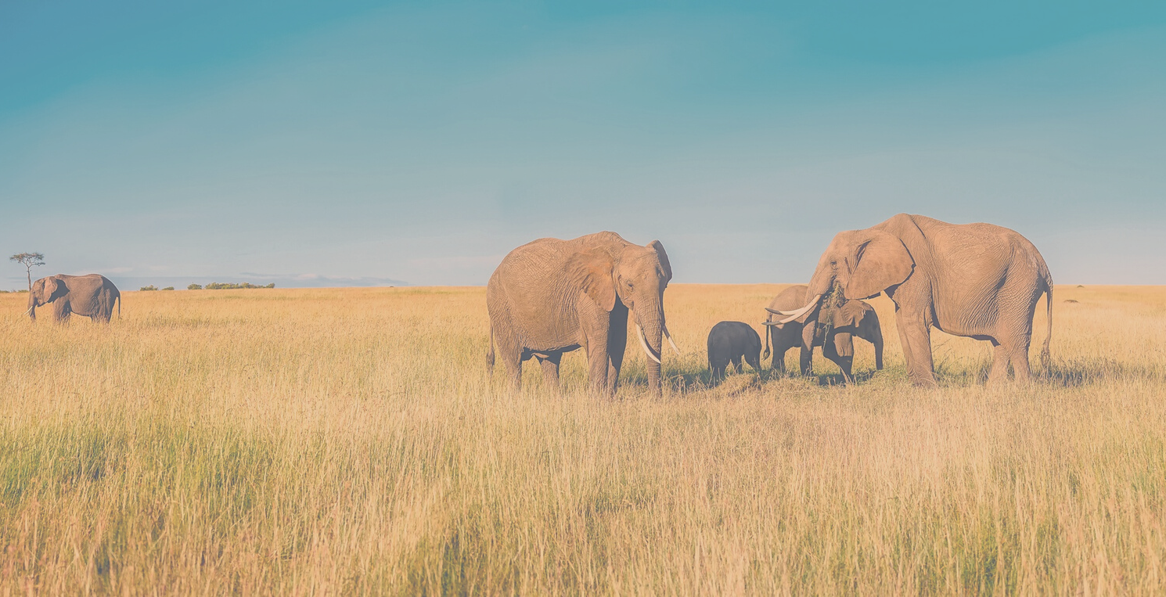
AFRICURA
Travel Recommendation System
Unlock Africa's Hidden Gems: Personalized Travel Recommendations at Your Fingertips!
01

Slide 2

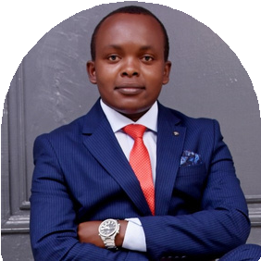
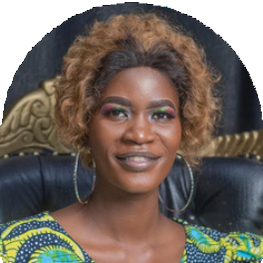
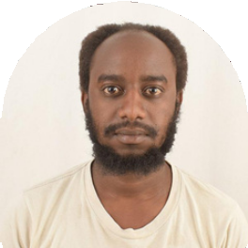
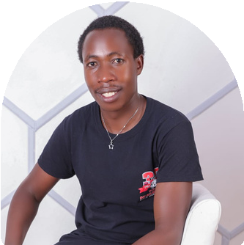
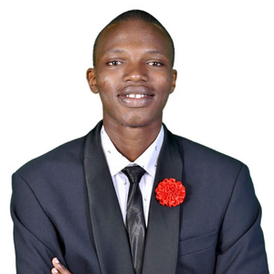
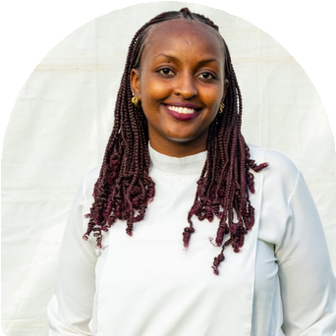

Introducing the Dream Team: Unleashing the Power of Data to Shape Your African Adventure!"
AFRICURA
Meet the team
Dennis Mwanzia
Pamela Awino
Ian Macharia
Kibet Kemboi
Kane Muendo
Pauline Wambui
Joshua Rwanda
02

Slide 3


CRISP-DM Roadmap
AFRICURA
This project was carried out using the CRISP-dm methodology
Business Understanding
Data Understanding
Data Preparation
Modeling
Evaluation
Deployment
03

Slide 4
Overview
AFRICURA
Tourism is a powerful vehicle for economic growth and job creation all over the world.
As African economies ease Covid-19 restrictions to strengthen their financial situations, the tourism sectors in the region are experiencing a resurgence.
A travel recommender system can drive tourism growth by delivering personalized recommendations, enhancing user experiences, promoting lesser-known destinations and continually improving its recommendations based on user feedback.
04

Slide 5

Problem Statement
AFRICURA
Tourists face immense challenges in finding suitable travel destinations that align with their preferences, budget, and time constraints.
The main aim of AfricuraAI is developing a recommendation system that suggests ideal tourist destinations based on customer reviews, budget limitations, specific locations and amenities
05

Slide 6

Business Understanding
AFRICURA
AfricuraAI is a business dedicated to revolutionizing travel exploration in Africa using machine learning.
AfricuraAI Recommendation system provides personalized recommendations for the best tourist destinations in Africa
06

Slide 7

Business Understanding
AFRICURA
Goals
Building a machine learning model to predict hotel ratings
Establishing evaluation metrics
Implementing a real-time recommendation feature Deploy the recommendation system using streamlit
Objectives
Creating a recommendation system based on budget.
Identifying top destinations in Africa
Fostering customer loyalty
Increasing customer engagement, generating revenue, and collecting user information and feedback
Success Metric
Root Mean Squared Error (RMSE) close to 0 to evaluate model efficiency
07

Slide 8

Data Understanding
AFRICURA
Data Mining
This data was for 15 top destinations in Africa which are Egypt, South Africa, Cape verde, Kenya, Uganda, Tanzania, DRC, Rwanda, Senegal, Morocco, Namibia, Madagascar , Ethiopia, Malawi, Ghana, Seychelles, Zambia
The data scrapped from Tripadvisor, stored in Json files and loaded into python
It contained 35836 rows and 65 columns. 8 Columns were of datatype integer and float while the rest were object columns.
08

Slide 9

Data Preparation
AFRICURA
1
SELECTING
We identified specific columns out of 65 that were relevant to the dataset
2
CLEANING
Cleaning involved removing missing values in the dataset and in othe cases filling using back filling and forward filling techniques.
3
FORMATING
Formating included extracting important attributes from the Json dictionaries.
4
FEATURE ENGINEERING
We formed new features like regional_rating from preexisting ones
09

Slide 10
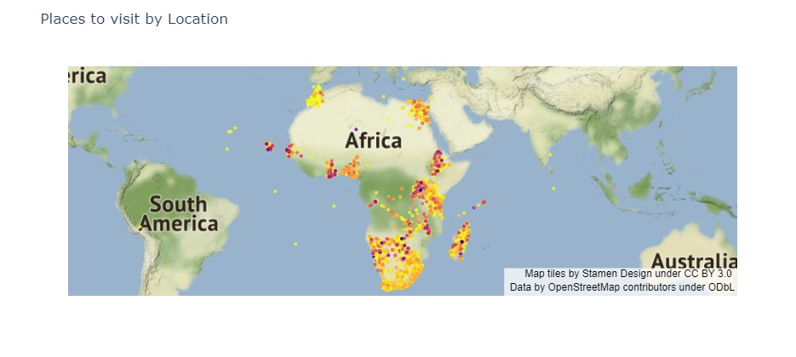
A map showing the distribution of attraction sites
AFRICURA
10

Slide 11
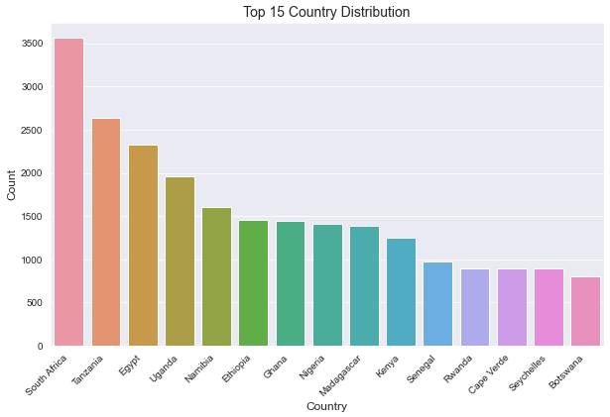
The distribution of destinations per country
AFRICURA
South Africa is the leading destination being followed by Tanzania and Egypt.
11

Slide 12

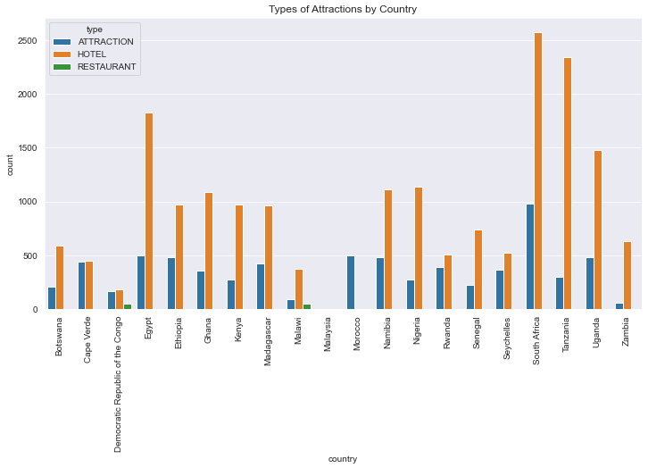
The distribution of attraction types per country
AFRICURA
Hotels are the leading attractions for tourist in all the countries followed by attraction. Restaurant is the least preffered attraction in all countries.
12

Slide 13
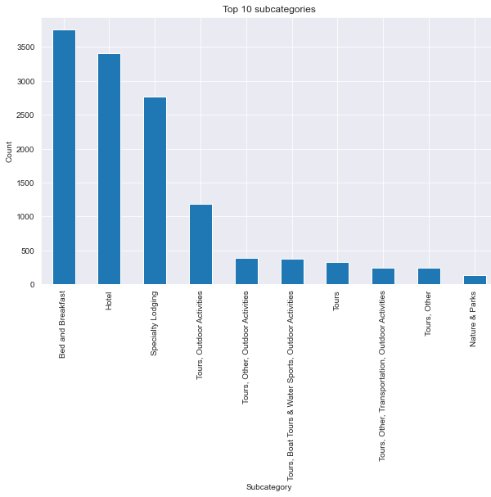
The graph shows the top subcategories for tourist destinations in Africa. Bed and breakfast leads followed by Hotel and speciality lodging.
14

Slide 14
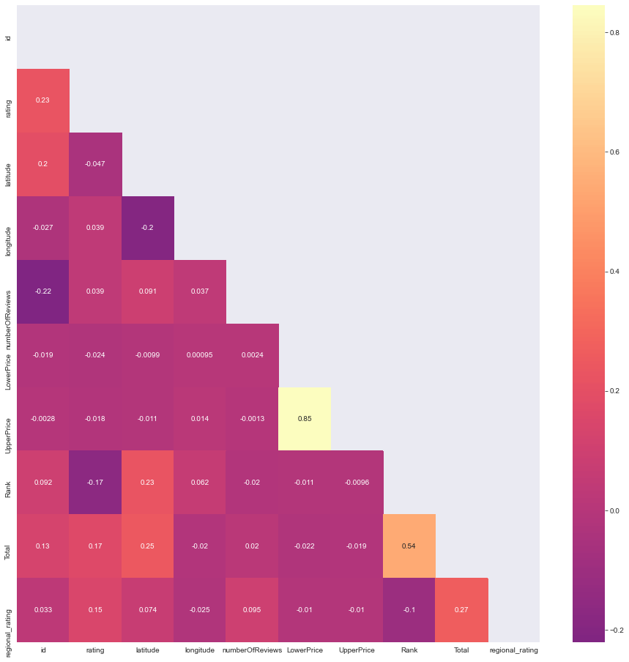
There appears to be very little correlation between features apart from upper and lower price.
14

Slide 15

MODELLING
AFRICURA
Baseline Root Mean Square Error (RMSE): 0.7157
Baseline Mean Absolute Error (MAE): 0.5230
KNN Basic Model
These metrics provide a measure of the model's prediction accuracy and the average difference between predicted and actual ratings.
14

Slide 16
MODELLING
AFRICURA
Root Mean Square Error (RMSE): 0.7066
SVD Model
Mean Absolute Error (MAE): 0.5142
A lower RMSE value of 0.7066 signifies improved accuracy in our predictions, indicating a reduction in the average error of approximately 0.7066 units.
16

Slide 17
MODELLING
AFRICURA
Root Mean Square Error (RMSE): 0.7157
NMF Model
Mean Absolute Error (MAE): 0.5103
With an RMSE of 0.7157 and an MAE of 0.5103, this model showcases its ability to accurately predict user ratings and provide personalized recommendations.

Slide 18
MODELLING
AFRICURA
Blended model achieves remarkable RMSE of 0.7034
Ensemble Methods
Mean Absolute Error (MAE): 0.5099
We scaled the data using MinMaxScaler for optimal feature representation and leveraged ensemble methods, combining NMF, SVD, and SVDpp models with
Majority Voting

Slide 19
DEPLOYMENT
AFRICURA
We deployed using streamlit.
The deployment has a landing page with the introduction and about , a recommendation page with sections to recommend based on countries, attraction, name of the place and amenities and a gallery page.

Slide 20

RECOMMENDATIONS
AFRICURA
User-Friendly Interface
Designing the travel recommender system with a user-friendly interface that is intuitive and easy to navigate, ensuring a seamless user experience.
Comprehensive Destination Coverage
Ensuring that the travel recommender system covers a wide range of destinations, both popular and off-the-beaten-path, to cater to diverse traveler preferences.
Real-Time Data Integration
Integrating real-time data sources, such as weather updates, local events, and tourist influx, to offer up- to-date and relevant recommendations to users.

Slide 21
CONCLUSIONS
AFRICURA
Continuous Improvement
By analyzing user feedback and travel patterns, the system continually learns and improves its recommendations, enhancing the overall travel experience for users.
Personalized Experiences
The travel recommender system offers tailored recommendations, enabling travelers to discover destinations and experiences that align with their interests.
Tourism Diversity
By showcasing lesser- known destinations, the recommender system can encourage travelers to explore new places, diversifying tourism and distributing visitor traffic more evenly.

Slide 22

Thank you
AFRICURA
22

